Slide 1
Notes:
[Advance slide to start]

Slide 2
Us and All of Us
Notes:
Introduce self.
Let me begin with a piece of scripture from The Gospel according to Matthew 22:34-40 [slide]

Slide 3
When the Pharisees heard that Jesus had silenced the Sadducees, they gathered together, and one of them, a lawyer, asked him a question to test him. “Teacher, which commandment in the law is the greatest?” Jesus said to him, “‘You shall love the Lord your God with all your heart, and with all your soul, and with all your mind.’ This is the greatest and first commandment. And a second is like it: ‘You shall love your neighbour as yourself.’ On these two commandments hang all the law and the prophets.”
(Matthew 22:34-40 - NRSV)
Notes:
³⁴ When the Pharisees heard that Jesus had silenced the Sadducees, they gathered together, ³⁵ and one of them, a lawyer, asked him a question to test him. ³⁶ “Teacher, which commandment in the law is the greatest?” ³⁷ Jesus said to him, “‘You shall love the Lord your God with all your heart, and with all your soul, and with all your mind.’ ³⁸ This is the greatest and first commandment. ³⁹ And a second is like it: ‘You shall love your neighbour as yourself.’ ⁴⁰ On these two commandments hang all the law and the prophets.” (Matthew 22:34-40 - NRSV)
I’d like to introduce you to someone today.
This is George. [slide]

Slide 4
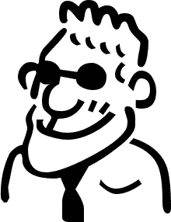
Notes:
George is a lot like all of us.
George goes about his life like most of the rest of us.
One of the things that does make George a bit different from many other people though, is George loves God.
George takes seriously the command of Jesus to love God with everything you are: Heart, soul, and mind. George loves God.
It makes George feel pretty good to know that God loves him; to think about all the things that God has done for George because God loves George.
God created George.
God loves George.
God came to be with George in Jesus.
God forgives George and renews George.
God shares with George everything that George has.
Yup, George loves God.
And because George loves God, George spends some of his time on a regular basis:
Praying –spending time in God’s presence.
Reading scripture –learning about God’s relationship with people.
But George doesn’t stop there. George also takes seriously the command of Jesus to love your neighbour as yourself.
George believes that God loves other people just as much as God loves George. George doesn’t always understand that, but he believes it none the less.
So when you watch George, you often might see him:
Participate in a Christian community – George comes to worship regularly and helps out around his church.
Serve & help the people around him.
Give generously – George knows it’s important both to his faith life and to his church to share from what God has shared with him.
Tell people about God’s love for them & invite them to join him.
So this is George.
And this is George’s bubble. [slide: add circle around George on screen]

Slide 5
Notes:
Inside George’s bubble are all the people that he meets and all the places that he goes, [slide: add people inside bubble]

Slide 6
Notes:
where he loves God with everything he is and loves his neighbour as himself.
But George has a problem. Along the way, George has noticed that there are lots of other people outside his bubble [slide: add background of other people outside bubble]

Slide 7
Notes:
who also need to know God loves them and need loving themselves.
This bothers George, because he knows how good it feels to love God and love other people, and he wants everyone to feel that good and be loved, but he is only one person and can only do so much.
So George thinks about this and prays about this and George comes up with a solution.
“If I can only do so much, by myself,” thinks George, “then I need some help.”
[slide: white screen]

Slide 8
Notes:
Now this is Florence. [slide: picture on screen]

Slide 9
Notes:
Florence is a lot like George [slide: add George]

Slide 10
Notes:
and a lot like all of us. Florence also takes seriously the command of Jesus to love God with everything you are: Heart, soul, and mind. Florence really loves God. Like George, Florence also believes that God loves other people just as much as God loves her and so she takes seriously the command of Jesus to love your neighbour as yourself.
Florence and George do a lot of the same things, and so just like George, Florence has come to the same place of realising that she can only do so much on her own to love her neighbours as she loves herself. [slide: add George and his bubble and people inside it and add Florence and her bubble with people inside it]

Slide 11
Notes:
So one day, George talks to Florence about this problem he has.
Florence can’t believe her ears, since she has the same problem, and so they decide to work together. In addition to loving God and loving their neighbours, they start to pool some of their resources. [slide: add square border]

Slide 12
Notes:
Doing that, they discover, helps them love even more people and let even more people know they are loved by God. This makes everyone feel good, too.
But eventually, the two of them once again find that they can only do so much. [slide: with people outside their joint bubble box]

Slide 13
Notes:
But this time they have a plan!
[slide: Just George & Florence]

Slide 14
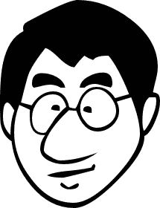
Notes:
and Florence talks to Lee [slide],

Slide 15
Notes:
George talks to Juan [slide],

Slide 16
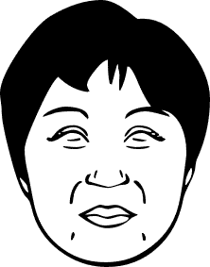
Notes:
and now there are four of them, each loving God and loving their neighbours [slide: add bubbles around each],

Slide 17
Notes:
and pooling some of their resources so that they can love even more people and let even more people know they are loved by God. [slide: add big square around all four]

Slide 18
Notes:
This makes even more people feel good, too.
And I bet you can guess where this is going! That’s right. The pattern keeps repeating itself [slide: shrink the 4 in shared box]

Slide 19
Notes:
as more and more people are welcomed [slide: add 4 more people and their individual bubbles]

Slide 20
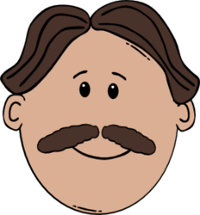
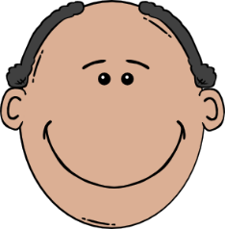
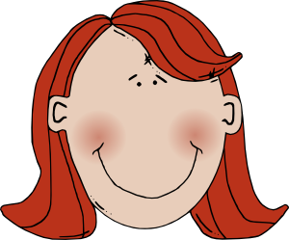
Notes:
and loved and in turn love God and love their neighbours, and then pool some of their resources [slide add outside box]

Slide 21
Notes:
so that they can love even more people and let even more people know they are loved by God.
And God feels pretty good about it, too.
[pause]
So, today I invite each of you to be like George and Florence and Juan and Lee [slide: the four]

Slide 22
Notes:
and consider sharing some of what you have for the larger work that we can only do together through Mission and Service. [slide]

Slide 23
Notes:
Your gifts to Mission and Service make it possible for you to love even more people and let even more people know they are loved by God, as together we: [slide]

Slide 24
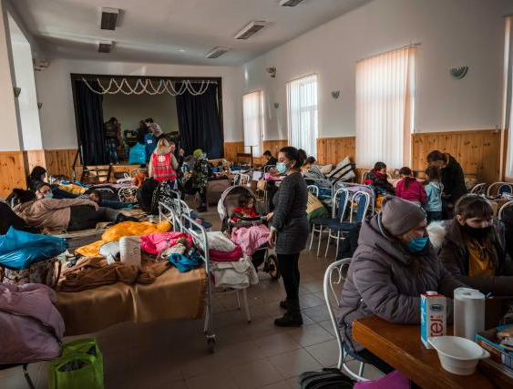
Food and Hygiene Kits For Ukraine
Notes:
Heal and rebuild [slide]

Slide 25
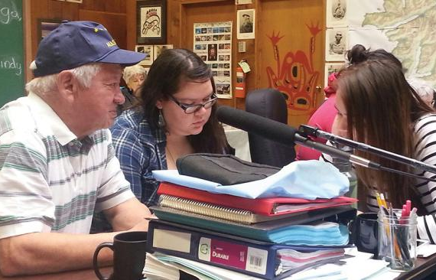
Elders Teach Words, Songs and Stories.
Notes:
Help Indigenous people to save their languages and preserve their culture [slide] Photo credit: Haida Gwaii Skidegate

Slide 26
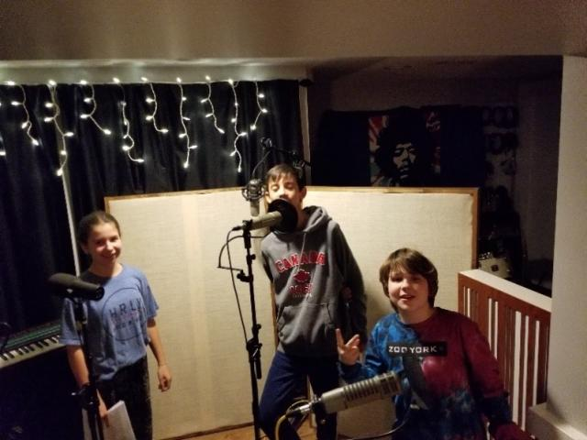
Inviting Children to Engage with Spiritual Questions
Notes:
Encourage young people’s creativity [slide] Photo credit: The Scribblers Story

Slide 27
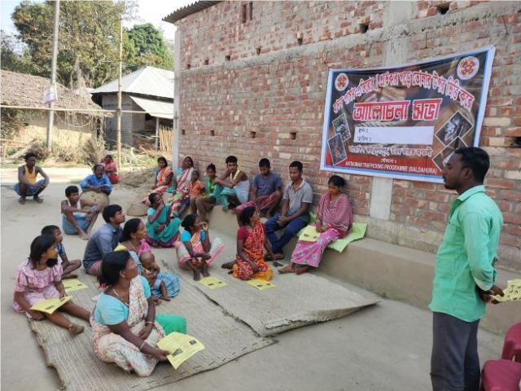
Training leaders in Anti-Human Trafficking
Notes:
Work for justice [slide] Photo credit: Diocese of Durgapur

Slide 28
Bunk #7 Theatre Performance
Notes:
Tell stories for reconciliation.
And so much more [slide] Photo credit: Copyright © The Raven Collective

Slide 29
Notes:
as together we make a real difference in the lives of people across Canada and around the world.
We can only do this together.
So, I invite you to make your gift today. [pause]
Thank you [slide]

Slide 30
Notes:
Thank-you for the ways that you share in the ministry of “all of us” that happens through Mission and Service.
Amen.
Photo credit: 26225236 © Justin Skinner | Dreamstime.com

